Slide 1
Webscraping Project
Karol Rochalski

Slide 2
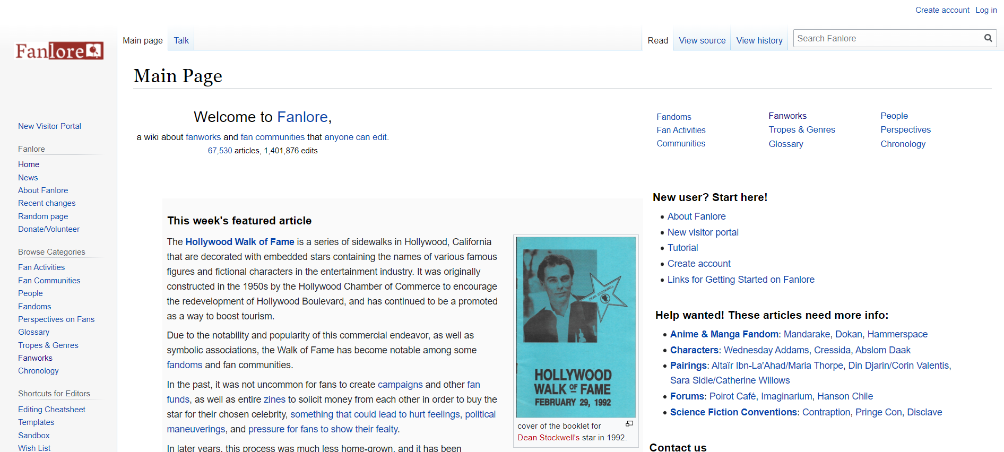
Fanlore

Slide 3
Structure of scrap
Root
|
|__Basic Information
|
|__Fandoms
|
|__Fan communities

Slide 4
Detailed structure
Fandoms
|
|__ structure of Fan fiction title
|
|__abstract
|
|__links
Fan commmunities
|
|__ structure of files
|
|__ summary
|
|__links

